Slide 1
SECURITY ARCHITECTURE REVIEW
Member Chatbot
Identity Control
Where member identity is enforced today, where it is not, and what closes the gap
Delta Dental of Michigan · September 2026 · Internal · Verified against the codebase
Notes:
Paste the official Delta Dental of Michigan logo in the clear area at the top left. Set expectations in the first sentence: a member-scope check does exist, it is real, and it is not yet a gate. This version is corrected against a code read; an earlier draft of these diagrams overstated the control and should not be circulated.

Slide 2
WHAT THE CODE DOES TODAY
Verified first, then enforced in each capability
01
No request is served before the member is verified
A session router checks whether a verified member is already in state. If not, the customer validation flow runs first — contact lookup, passcode send, passcode check — and verified state is written only on a verification success, so no failed or partial attempt leaves a usable session.
02
The benefit validator reads server-side state
The benefit validator reads the verified set from session state and makes no call for a patient outside it. The passcode tools have no such validator because they are what establishes verification — they do their own member and contact lookups and return a verification outcome or no data.
03
The enforcement lives in the capabilities, not at dispatch
Nothing checks member scope at tool dispatch, so coverage is the sum of what each capability does for itself. That works today, but it is a convention rather than a property of the architecture.
The service token on every backend call authenticates the application, not the member, and the MCP services are stateless. So wherever a capability does not check member scope itself, nothing downstream checks on our behalf.
Notes:
This is the slide that replaces the earlier claim of a universal deterministic gate. Be straightforward: the design intent is right, the implementation covers one tool. Statement 3 is the one security will care about most, because the prompt actively steers the common question to the unchecked tool.

Slide 3
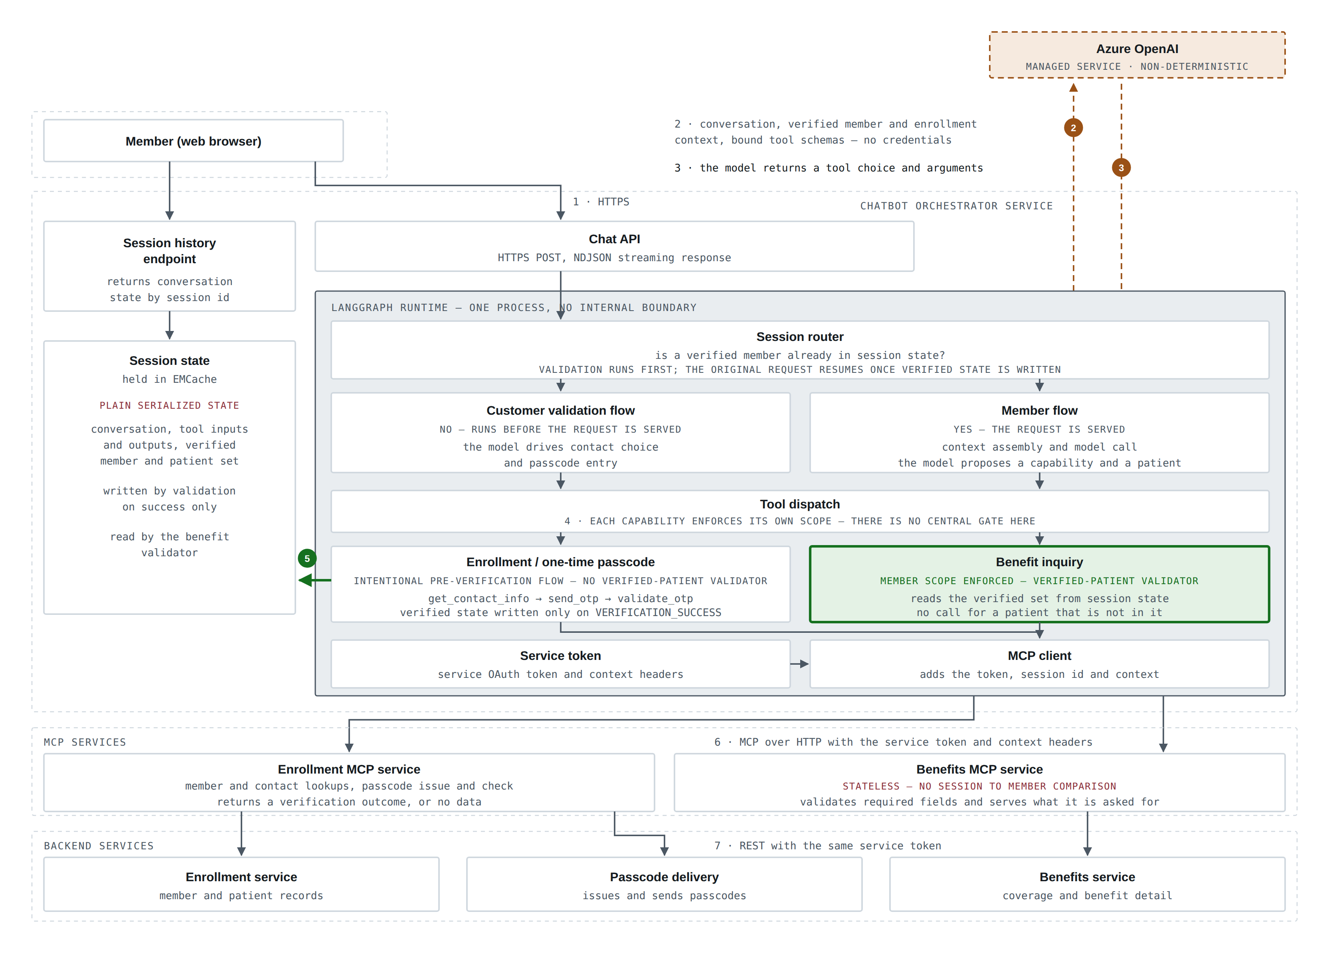
ARCHITECTURE
The whole system, as the code has it
A router decides whether validation runs before the request is served. The passcode tools are that pre-verification flow and write verified state only on success; the benefit validator then reads that state on every later request.
Notes:
Walk the router first: no verified member in state means identity proofing runs before anything is served, and the original request only resumes once the verified member and patient set is written — so an unverified caller cannot reach a capability at all. Then the three capabilities: the two benefit paths refuse an unverified patient, and the enrollment path matches the patient and builds its request from saved state, but on a miss it calls anyway and leans on the service to refuse. That is the amber box — a narrow fail-open, not a missing check. The structural point is that all of this is per capability rather than at dispatch. Finally, the grey panel is one process, and the session history endpoint on the left is a second client-reachable surface.

Slide 4
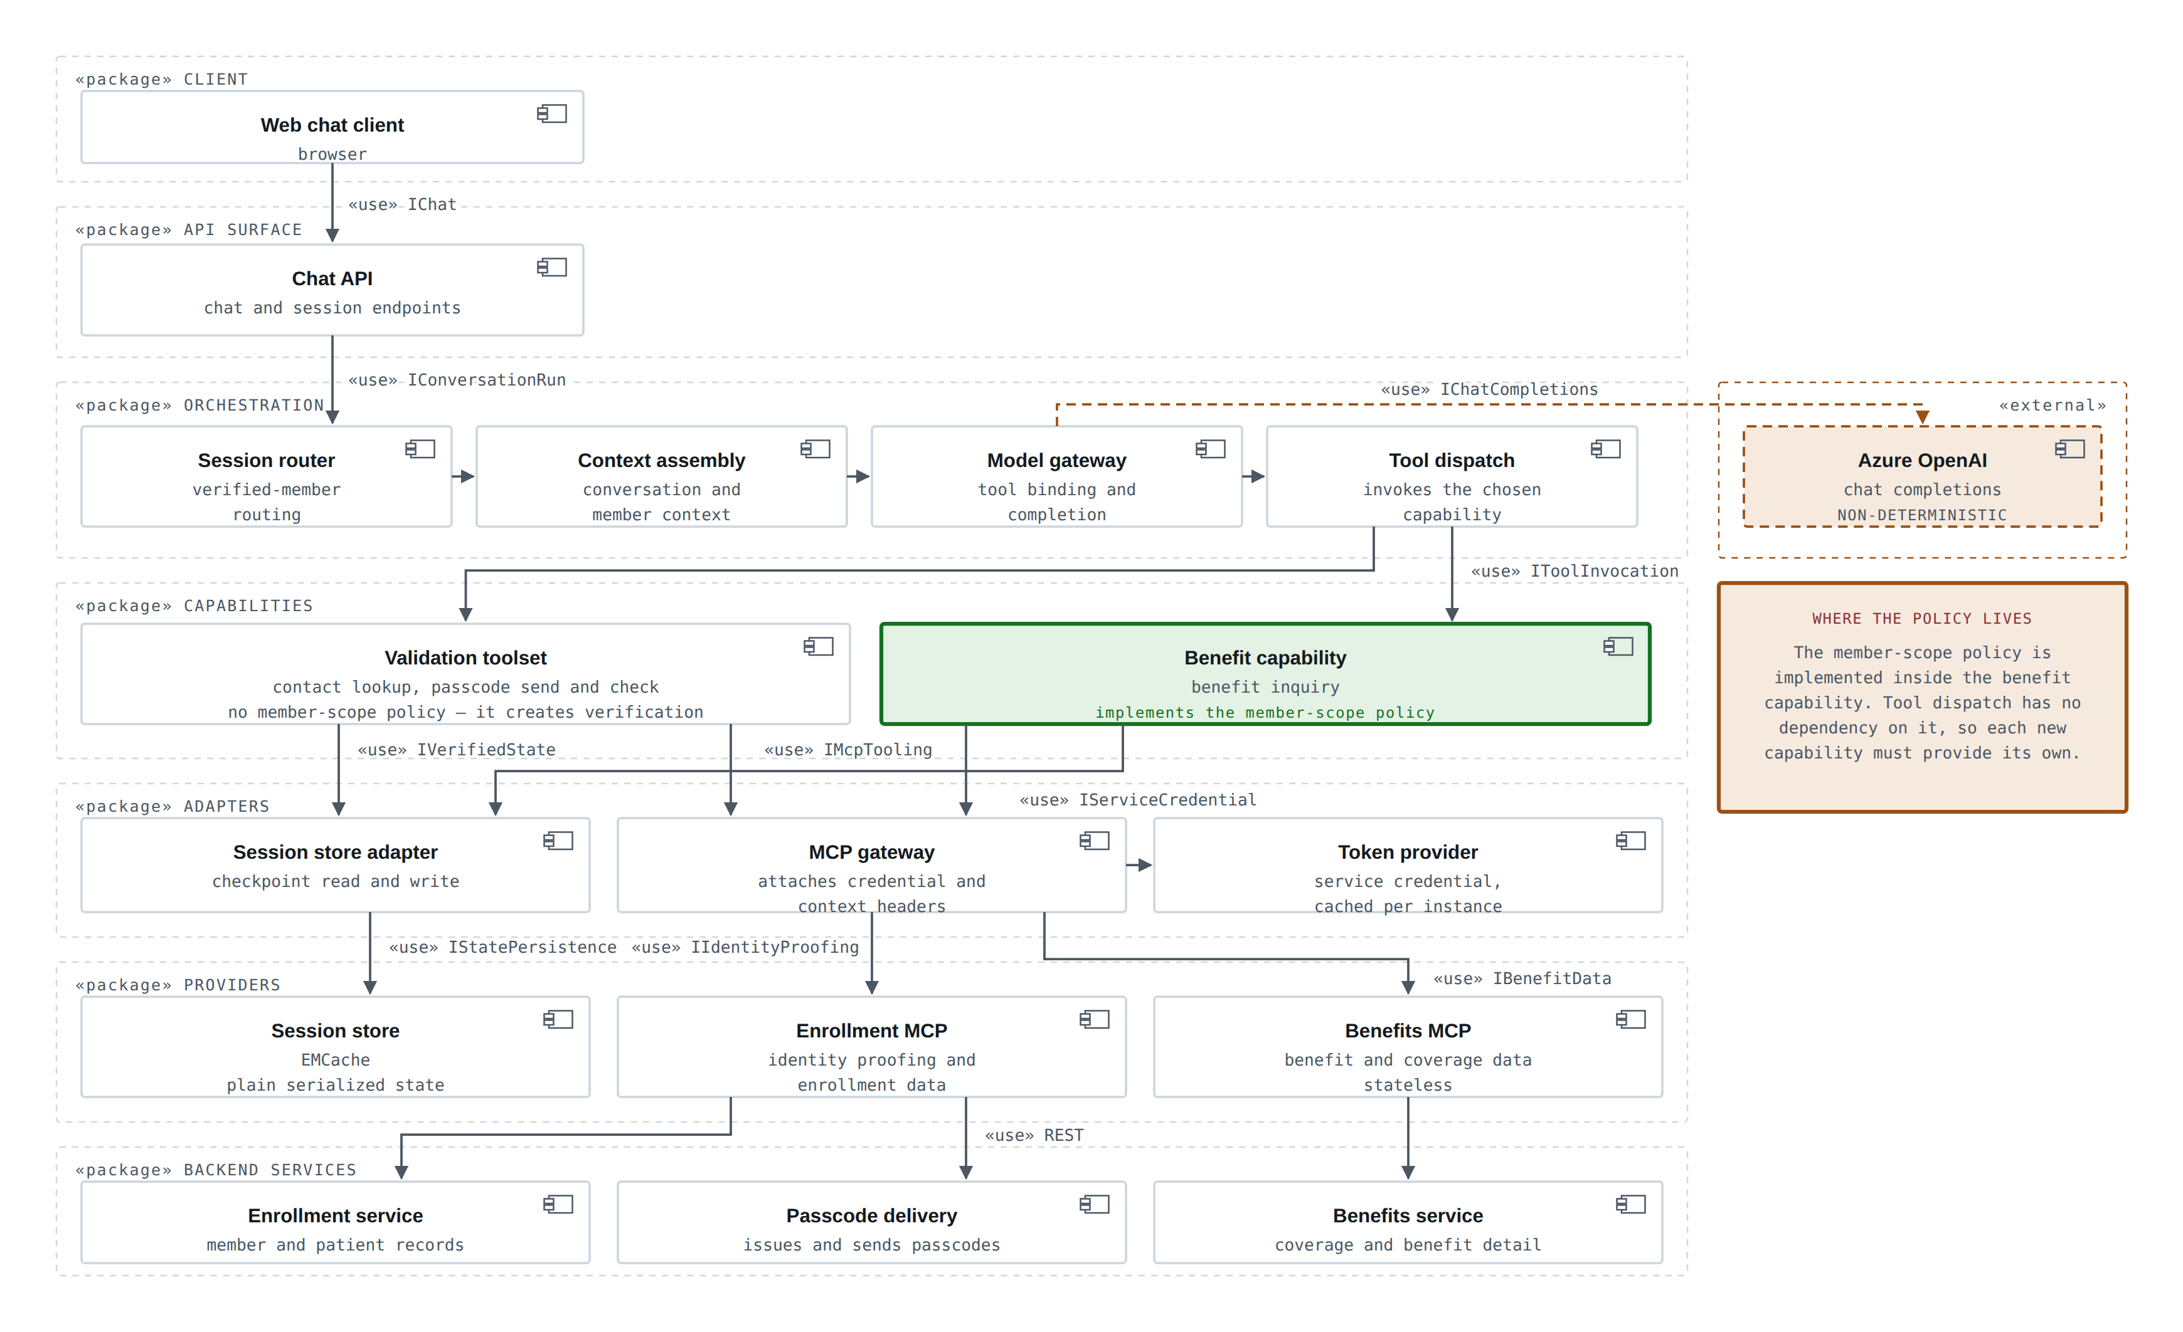
LOGICAL COMPONENTS
The parts, and what each one depends on
Components, the packages they belong to, and the interface each dependency runs over. Tool dispatch depends on no member-scope interface — the policy sits inside the benefit capability.
Notes:
Use this slide for the structural question rather than the runtime one: what would have to change, and what does a new capability inherit. Read it top down — client, API surface, orchestration, capabilities, the adapters that reach outward, the MCP and state providers, and the backend services behind them. Two things to point at. First, the green box: the member-scope policy is a dependency of the benefit capability, not of tool dispatch, so nothing in the orchestration layer publishes or requires it — that is the same finding as the architecture slide, stated as structure. Second, the only dependency that leaves the organization is the chat completions interface to Azure OpenAI; every other dependency terminates on an internal component. The validation toolset has no member-scope dependency by design, because it is what creates verified state in the first place.

Slide 5
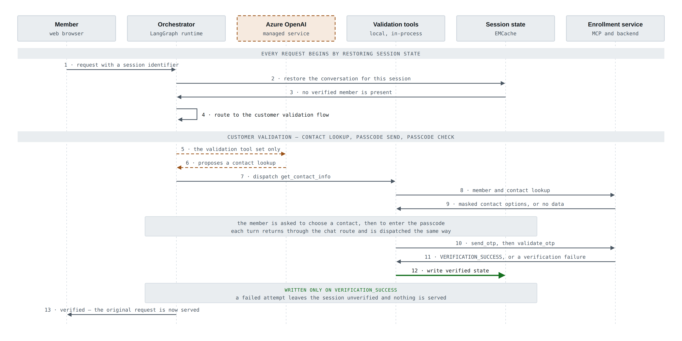
SEQUENCE 1 OF 2
A new session: validation before anything is served
The request the member asked for waits until verification succeeds. On this path the model is given only the validation tool set, so there is nothing else it could choose.
Notes:
The point of this slide is that verification is not optional and not concurrent — the original request is parked until it completes. Two details worth calling out. Step 5: only the validation tools are bound on this path. Step 12 and the note under it: verified state is written on a verification success and nothing else, so an abandoned or failed attempt leaves nothing behind that a later request could pick up. The validation tools have no verified-patient check because they are what creates verification; they do their own member and contact lookups and return either an outcome or no data.

Slide 6
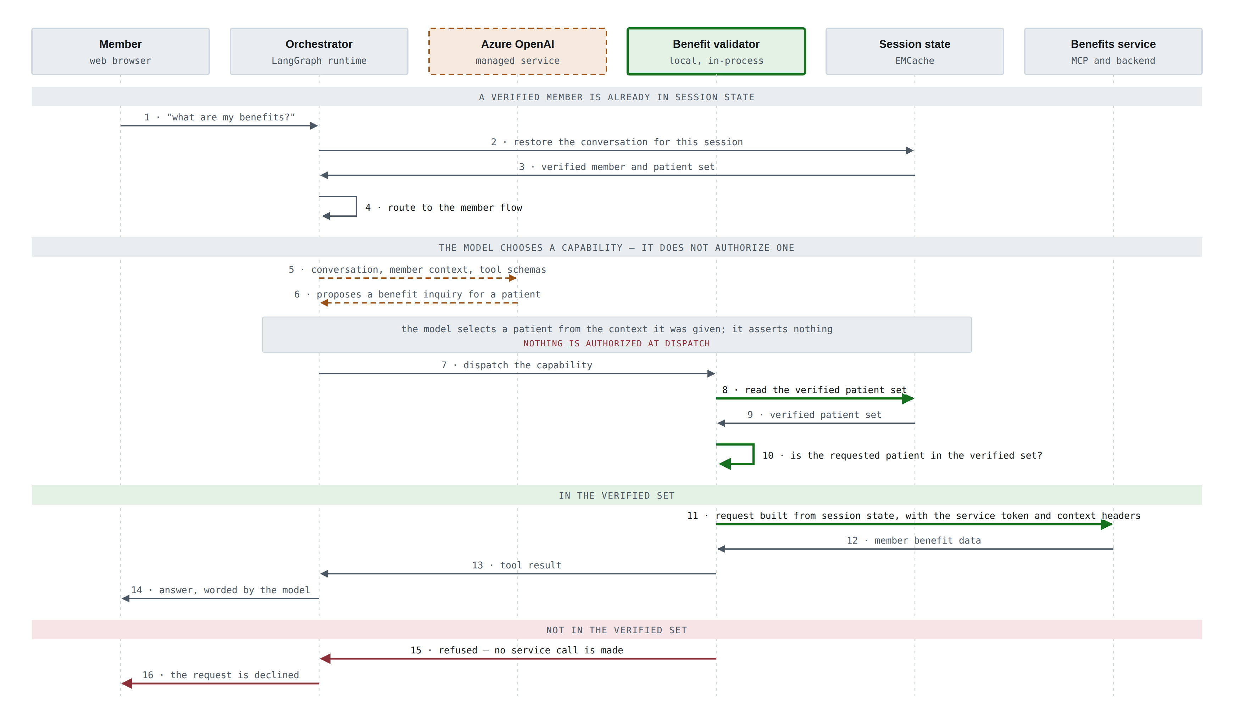
SEQUENCE 2 OF 2
A verified session: the request is served
Steps 7 to 10 are the control. The model names a patient; application code tests that name against the verified set in session state before anything is retrieved.
Notes:
This is the slide to spend time on. Walk steps 6 through 10 slowly. The model proposes a patient — that is a selection from context, not an assertion of identity, and nothing is authorized at dispatch. The validator reads the verified set from session state and tests the requested patient against it. On a match, note that the downstream request is built from session state rather than from the model's arguments. On a miss the benefits service is never called, so a hallucinated or injected patient fails closed. If asked the obvious question — what if the model invents a patient id — this diagram is the answer. The caveat to state honestly is step 7: nothing is checked at dispatch itself, so this is a property of the capability rather than of the runtime.

Slide 7
FINDINGS — MAJOR
Five things a reviewer needs to know
Each confirmed by reading the source. Line-level references are in the written review for the engineering team.
MAJOR
Enforcement is per capability, with no central gate
Each capability enforces member scope for itself; nothing enforces it at tool dispatch. Coverage therefore depends on every current and future capability implementing the check.
Evidence: app/agents/local_tools/ — per-capability checks
MAJOR
An ID-card lookup does not hard-reject an unmatched patient
A member-data lookup — separate from the passcode tools — matches the patient and builds its request from saved state, but on a miss it still calls the service with a zero patient identifier and relies on it to refuse.
Evidence: app/agents/local_tools/enrollments/wrapper_tools.py
MAJOR
A second surface returns conversation state by session id
It returns stored conversation state for whatever session identifier it is given, without the ownership check used on the chat route.
Evidence: routes/agent_routes.py — session history route
MAJOR
session_id is caller-supplied and maps straight to the thread
The session identifier comes from the request body and becomes the conversation key directly. No check ties it to an authenticated caller.
Evidence: routes/agent_routes.py
MAJOR
One capability still takes request fields from the model
On the benefit path the subscriber identifier and member type come from the model's tool arguments and are forwarded downstream, rather than resolved from saved state as the enrollment path does.
Evidence: benefit_interpreter.py · benefit_interpreter_graph.py
Notes:
Lead with the second one if time is short: it is the one an attacker or a confused member reaches by accident, because the prompt routes the most common question there.

Slide 8
FINDINGS — MODERATE
Four more worth stating plainly
Lower severity, but each one weakens an assumption a reviewer might otherwise make.
MODERATE
Session state is plain and not tamper-evident
Stored state holds the conversation, tool inputs and outputs and the verified member context, keyed from the supplied session identifier. It is not a signed member assertion.
Evidence: app/agents/models.py · features/checkpointers/emcache_saver.py
MODERATE
The prompt carries member PII, with no redaction layer
The assembled prompt carries subscriber verification data, address, verified patient names, dates of birth, person identifiers, dependent types and active enrollments, plus unredacted conversation history. No redaction layer exists.
Evidence: app/agents/graphs.py · app/agents/models.py · app/agents/prompts/memory.j2
MODERATE
The Benefits MCP is stateless by design
It reads the token and context headers, validates required fields and enrollment identifiers, then calls the backend. It holds no passcode state and makes no session-to-member comparison.
Evidence: ria-benefit-mcp-se-v01 — benefits MCP router
MODERATE
"The same token end to end" is not proven
The orchestrator mints and caches a service token and attaches it to outbound calls. Each instance has its own cache, and downstream adapters may use it differently — this is not proof that backend authorization is application-identity-only.
Evidence: features/security.py · features/mcp_client.py
Notes:
The PII finding is the one a privacy reviewer will pick up independently, so it is better for us to raise it. Nothing here says the prompt payload is wrong — it says there is no layer that would stop it growing.

Slide 9
GAPS IN THE CURRENT CODEBASE
Two gaps around the session checkpoint
Both sit on the same object: the saved session state that holds the verified member and patient set every capability reads.
CRITICAL
CONFIDENCE 8 / 10
Cache checkpoints have no integrity protection
No encryption, no MAC or signature, no cache authentication and no TLS configuration. Attacker-controlled checkpoint data may be deserialized. The RCE and state-forgery impact is conditional on cache-write access.
Why it matters: the checkpoint is where the verified member and the verified patient set live. Every capability trusts that state, so a store that is neither authenticated nor tamper-evident undermines the check each capability performs.
features/checkpointers/emcache_saver.py : 20–119
HIGH
CONFIDENCE 10 / 10
Session history is returned for any session id supplied
GET /sessions/{session_id}/history returns raw saved state for a caller-supplied session ID without an in-code owner or principal authorization check.
Why it matters: it reads back the same saved state without proving the caller owns that session — the read path to the object above.
routes/agent_routes.py : 486–528
Notes:
Two findings, one object. Lead with the relationship rather than the severities: the first is about whether the saved session state can be trusted, the second is about who can read it back. On the critical one, keep the qualification the scan itself makes — the forgery and deserialization impact is conditional on cache-write access, so the honest framing is that the store holding our identity decision has no integrity control, not that remote code execution is demonstrated. The point to land is that the member-scope check on the earlier slides reads its answer out of this checkpoint, so these two gaps sit underneath the control rather than beside it. Confidence scores are the scan's own and are shown so no one has to ask.

Slide 10
REMEDIATION
Turning the check into a control
1
Move the check to the dispatch layer
Enforce member scope once, where tools are invoked, so a new capability cannot ship without it.
2
Make the enrollment path fail closed
Reject an unmatched patient locally instead of calling the service with a zero identifier and relying on it to refuse.
3
Keep the model out of identity everywhere
The enrollment path already resolves its fields from saved state; apply the same rule to any field another capability still takes from tool arguments.
4
Bind the session to a caller
Tie the session identifier to an authenticated principal, or sign it, so a supplied identifier cannot address another member's conversation.
5
Add a member-scope check at the MCP layer
Defence in depth, so the control does not depend on every caller being well behaved.
Items 1 to 3 are the ones that change the risk picture. The rest reduce how much has to go right for the control to hold.
Notes:
If asked for a single fix, it is number one: the benefit capabilities do enforce scope today, but that is a property of each capability rather than of the architecture, so it has to be re-earned every time a tool is added.

